Slide 1
Viewports and Render Targets
DirectX Day 7

Slide 2
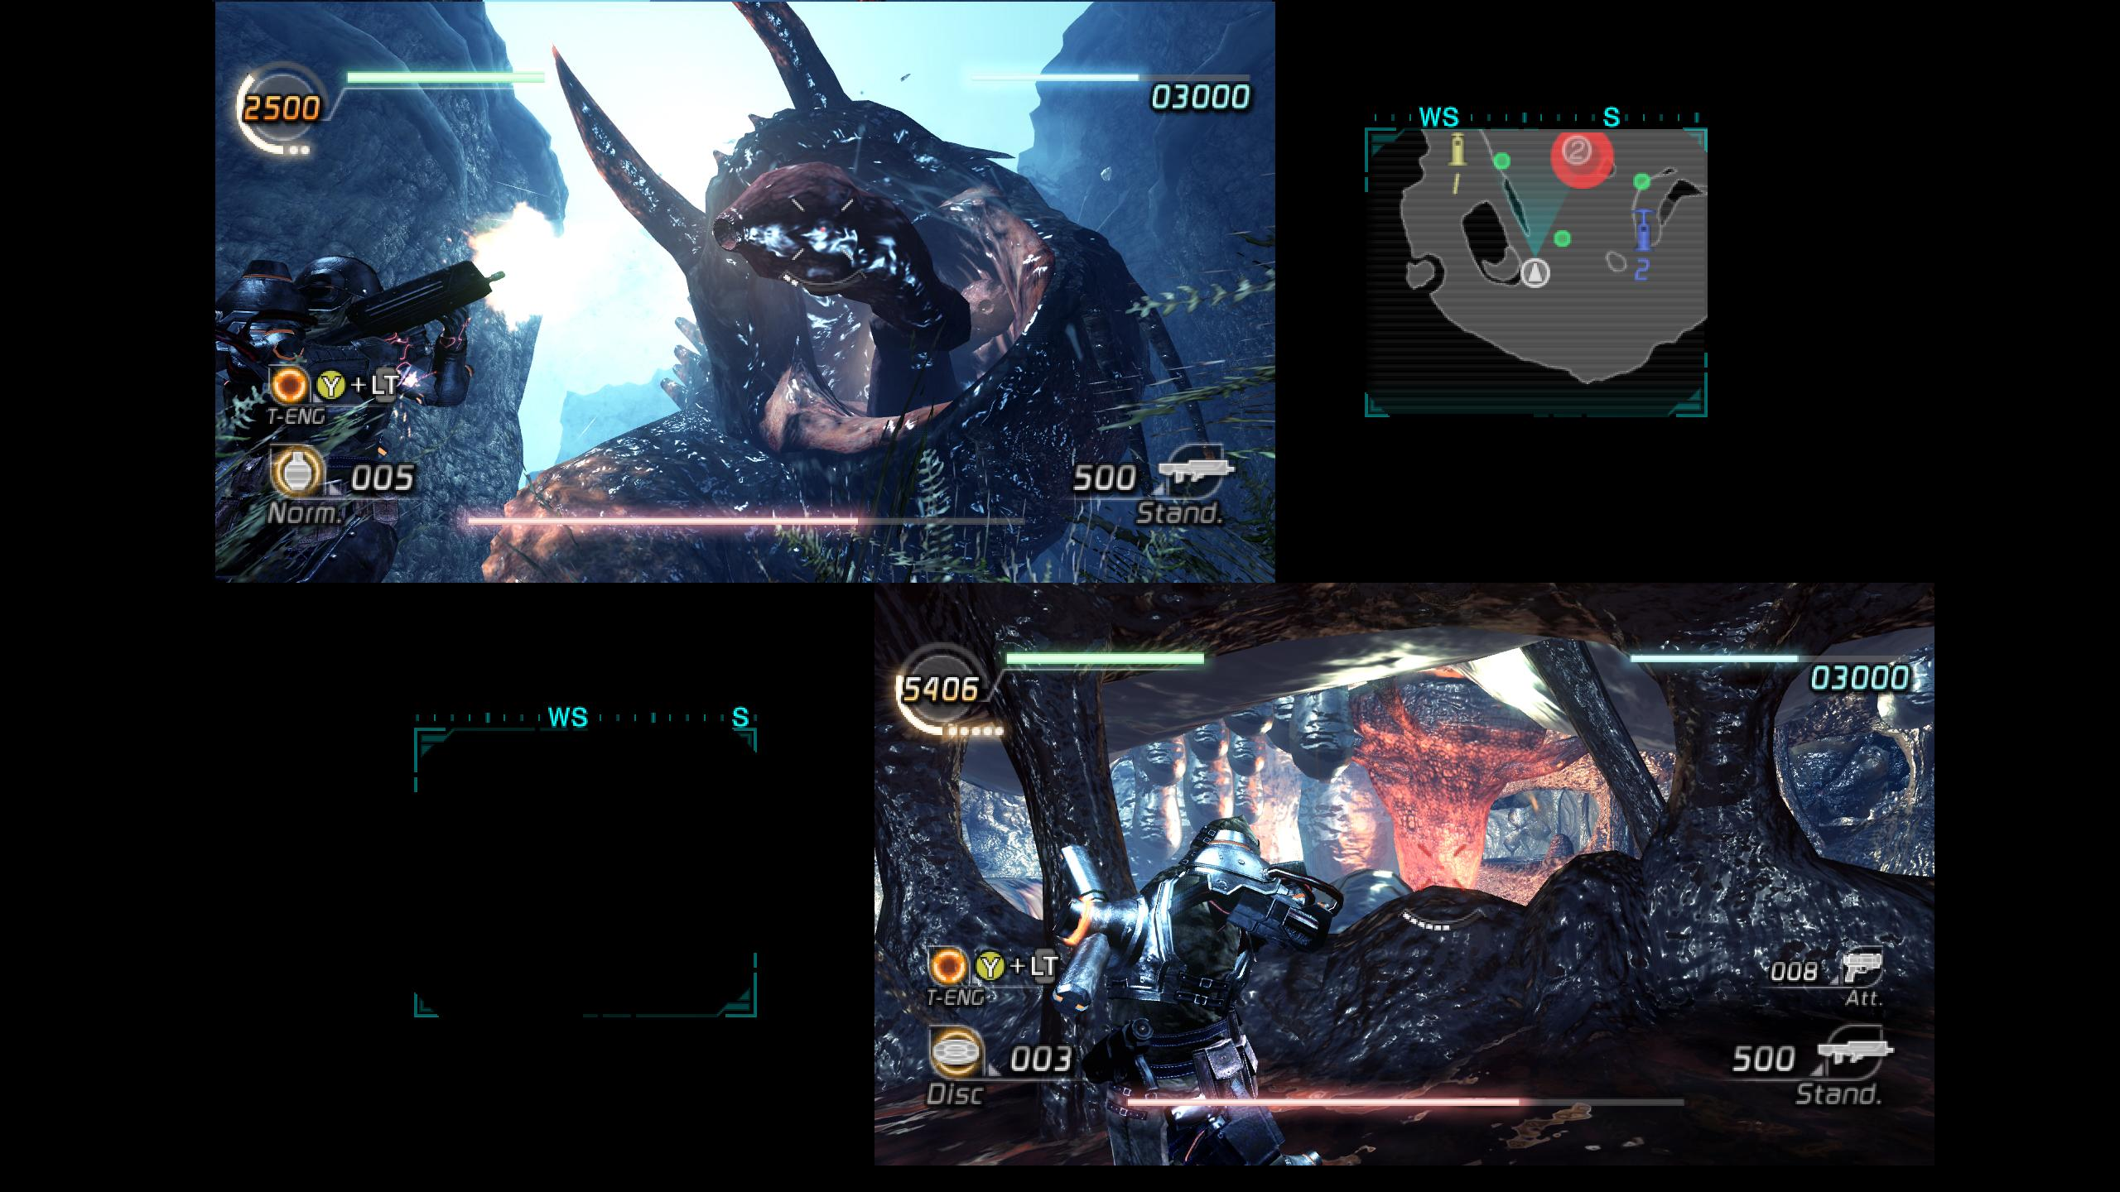

Viewports

Slide 3
Viewport Applications
Most commonly used for split-screen.
Viewports can overlap so they are also useful for mini-maps or rear-view mirrors.
In a 3D environment your viewports should each have their own View & Projection Matrices.
Viewports are always rectangles, so if you need something more complex look into Render To Texture or Stencil Buffers.

Slide 4
Using Viewports
Call “RSSetViewports” from the ID3D11DeviceContext.
The rasterizer will use viewport[0] by default.
You may target multiple viewports concurrently with the geometry shader stage.
To do so tag outgoing primitives with the “SV_ViewportArrayIndex” system semantic.
This is a very powerful feature. It has the potential to significantly boost rendering speeds when having to draw the same data transformed differently to multiple locations.
For example: Render a shared HUD element to all 4 screens in multiplayer game in one draw command.

Slide 5
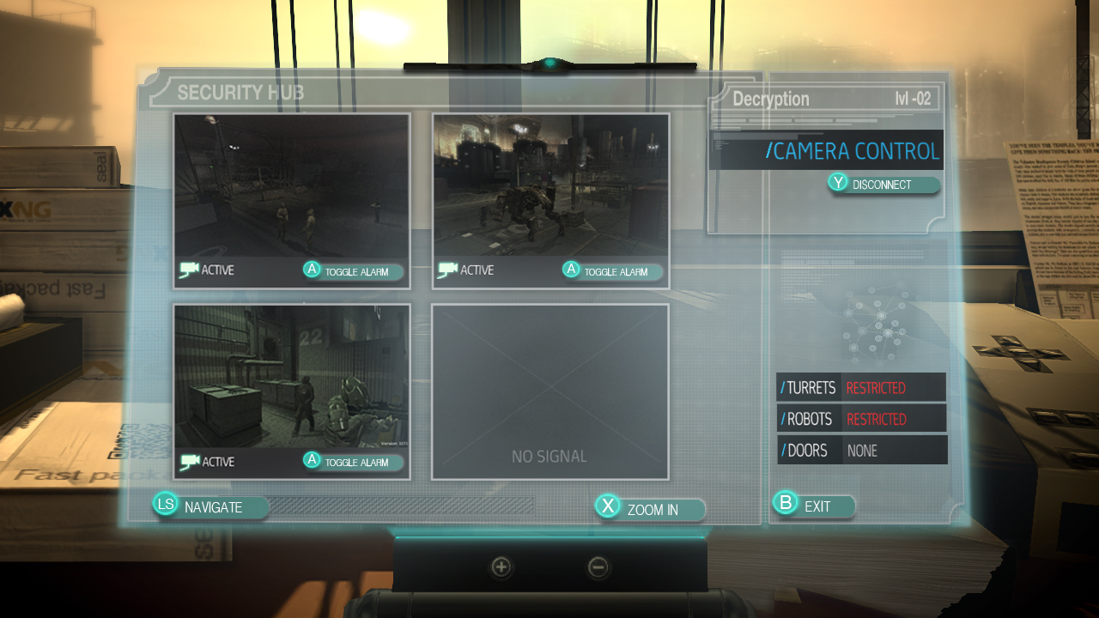

Render To Texture

Slide 6
RTT: Applications
Whereas viewports allow you to break apart an existing surface, Render To Texture allows you to draw to a different surface altogether.
The most obvious use of Render to Texture is to build dynamic textures that can be mapped onto geometry within the main 3D environment.
Examples: Televisions, Security Cams and Dynamic Billboards.
Render To Texture or “Off-screen Rendering” also has many other less obvious uses.
Shadow Mapping, Pre-Pass Lighting, Deferred Shading, Post-Processing, etc..

Slide 7
Using Render To Texture
Create an Off-screen 2D texture to hold the results of our rendering.(common settings)
BindFlags: D3D11_BIND_RENDER_TARGET | D3D11_BIND_SHADER_RESOURCE
Format: DXGI_FORMAT_R8G8B8A8_UNORM_SRGB
MiscFlags: D3D11_RESOURCE_MISC_GENERATE_MIPS
Before Rendering
Set proper render target, viewport & matrices.
Clear previous color and Z buffer data.
After Rendering
If output is used for 3D call “GenerateMips()”

Slide 8
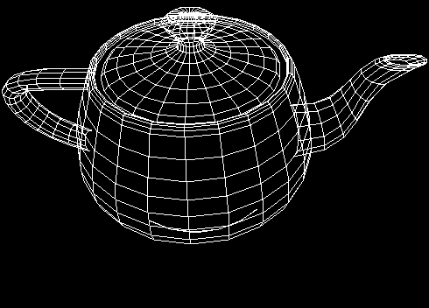
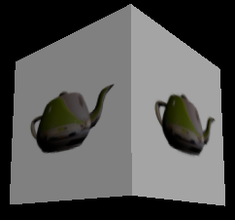
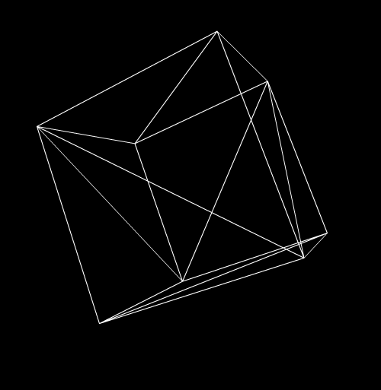

RTV
VP
PM
VM
VB
Back Buffer [Tex2D]
IB
Depth Buffer [Tex2D]
DSV
WM
DSV
OFF-SCREEN GEO
Static Cube-Map Texture From File
SRV
SHADERS & PIPELINE
DRAW
DRAW
RTV
VM
PM
VB
SRV
Render Target [Tex2D]
IB
WM
SRV
ON-SCREEN GEO
VP

Slide 9
Tips For Homework:
Remember: Viewports and RTT don’t change HOW we draw, they modify WHERE we draw!
Viewports don’t have to be used only on the back-buffer. Use them on off-screen Render Targets as well.
Render To Texture is a great candidate for multi-threaded rendering using deferred contexts.

Slide 10
Shadow Mapping
Shadow mapping is one of two common techniques used to determine if a pixel is visible to a light source.
Using render to texture we draw the visible geometry using the direction and position of the light source to rasterize the data from the light’s point of view.
Instead of outputting color we store the depth of each pixel. This represents the distance of each rasterized pixel to the light source.

Slide 11
Shadow Mapping Continued
This new texture containing depth information from the light’s point of view is known as the “Shadow Map”.
Now we render our scene normally from the camera’s point of view to the back-buffer.
To determine if a rasterized pixel is in shadow, we transform it into the lights space and check it’s distance to the light against the value stored in the shadow map at the same location.
If our pixel is further from the light than the stored value then we know this pixel is in shadow.

